Slide 1
Reference Sequence:
ATG TCT GGA TAC CCG AAT GTC
ATG TCA GGA TAC CCG AAT GTC
Substitution
ATG TCT TAC CCG AAT GTC
Deletion

Slide 2
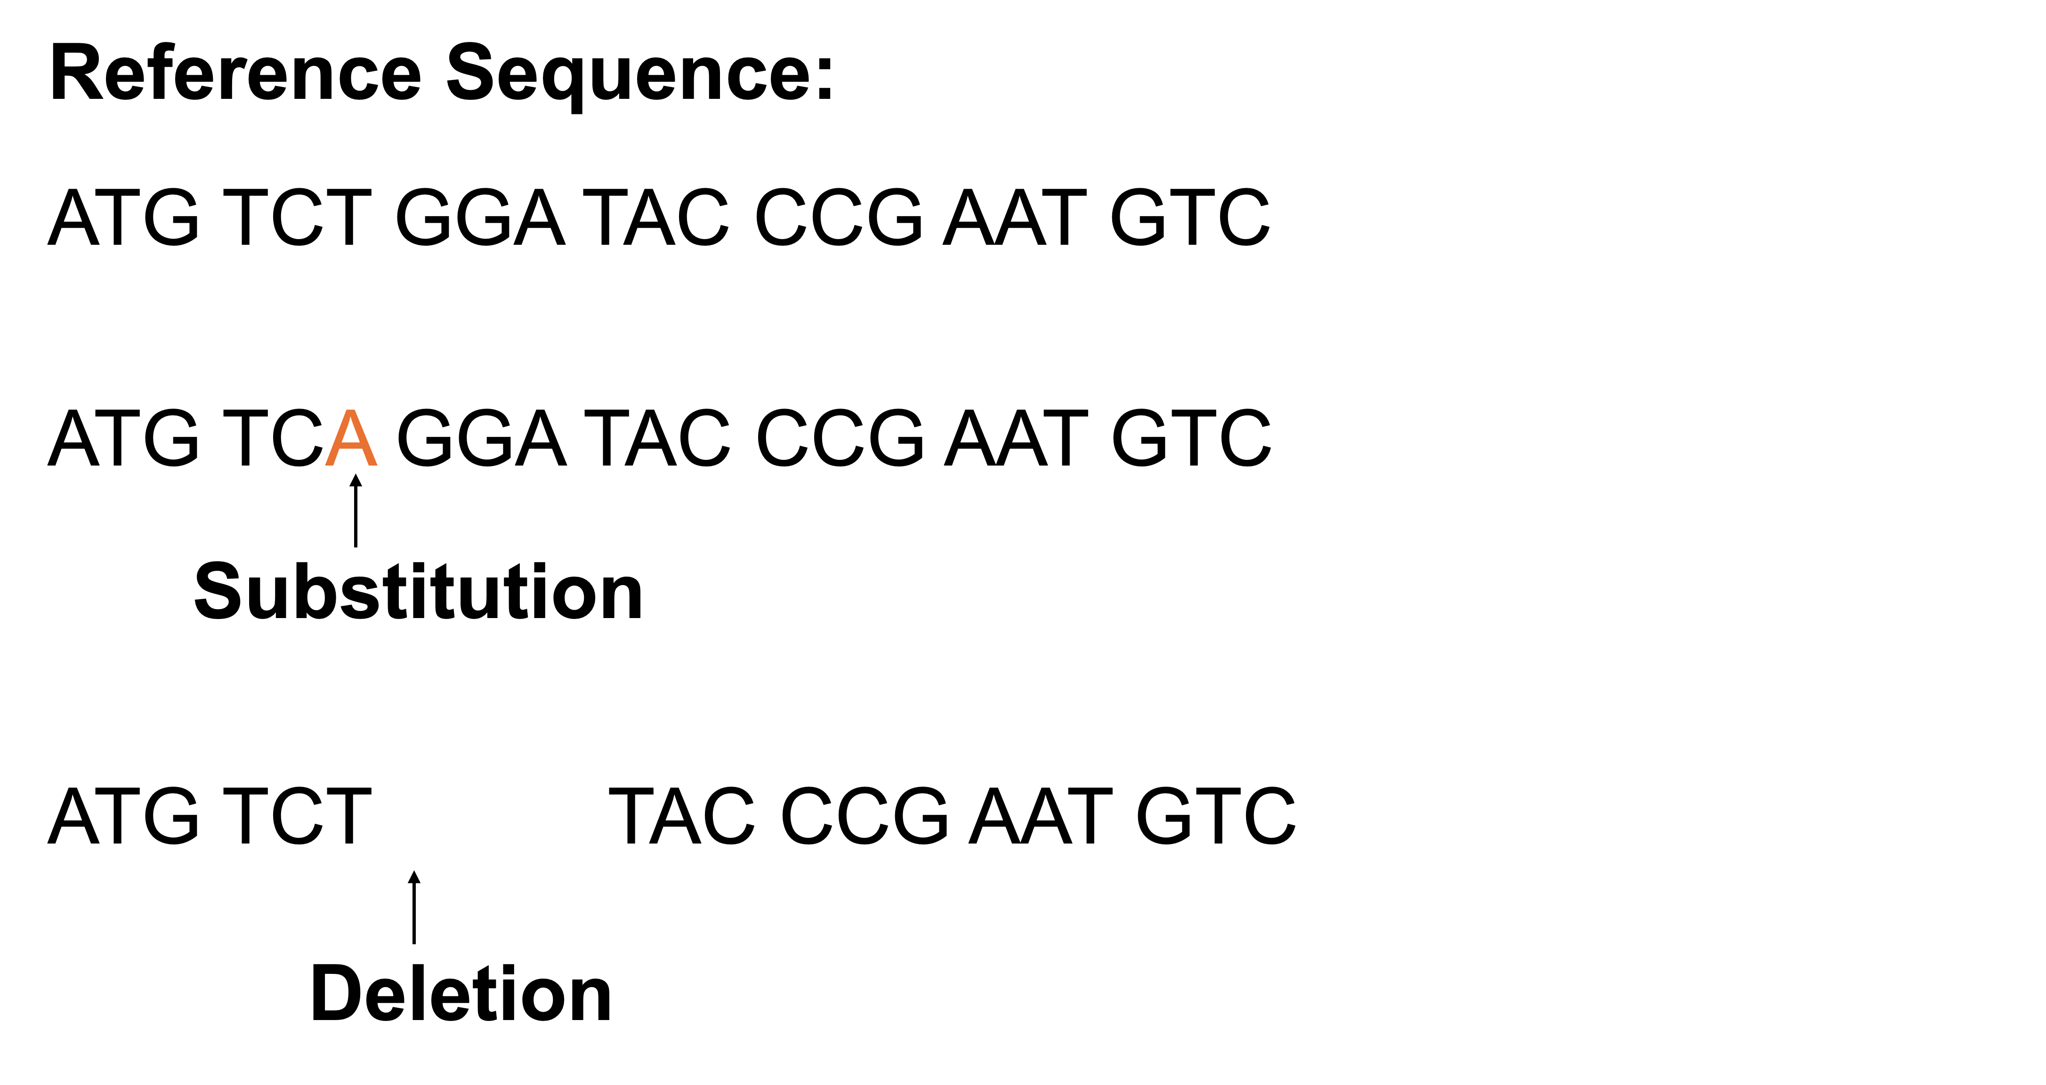
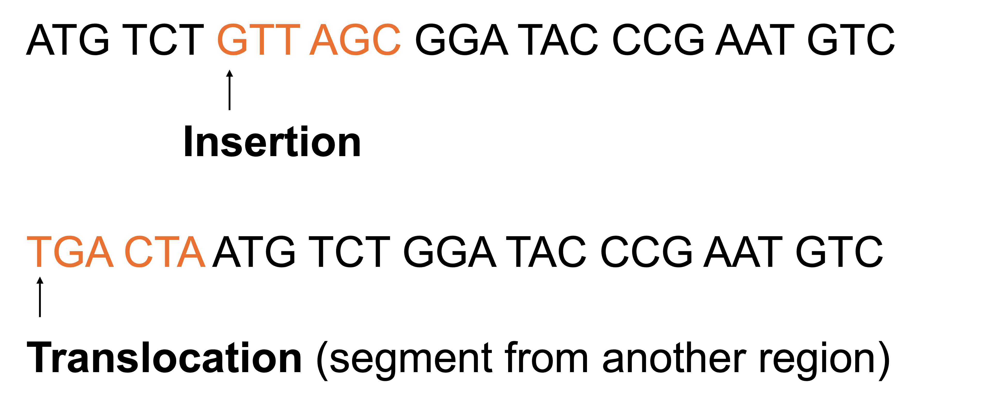

Slide 4
ATG TCT GTT AGC GGA TAC CCG AAT GTC
Insertion
TGA CTA ATG TCT GGA TAC CCG AAT GTC
Translocation (segment from another region)

Slide 5

Individual 1:
Allele A
C T C G T C A C T T C A C
G A G C A G T G A A G T G
C T C A T C A C T T C A C
G A G T A G T G A A G T G
Allele a
The genotype at this SNP: Aa

Slide 6
Individual 2:
Allele a
C T C T T C A C T T C A C
G A G A A G T G A A G T G
C T C A T C A C T T C A C
G A G T A G T G A A G T G
Allele a
The genotype at this SNP: aa

Slide 7
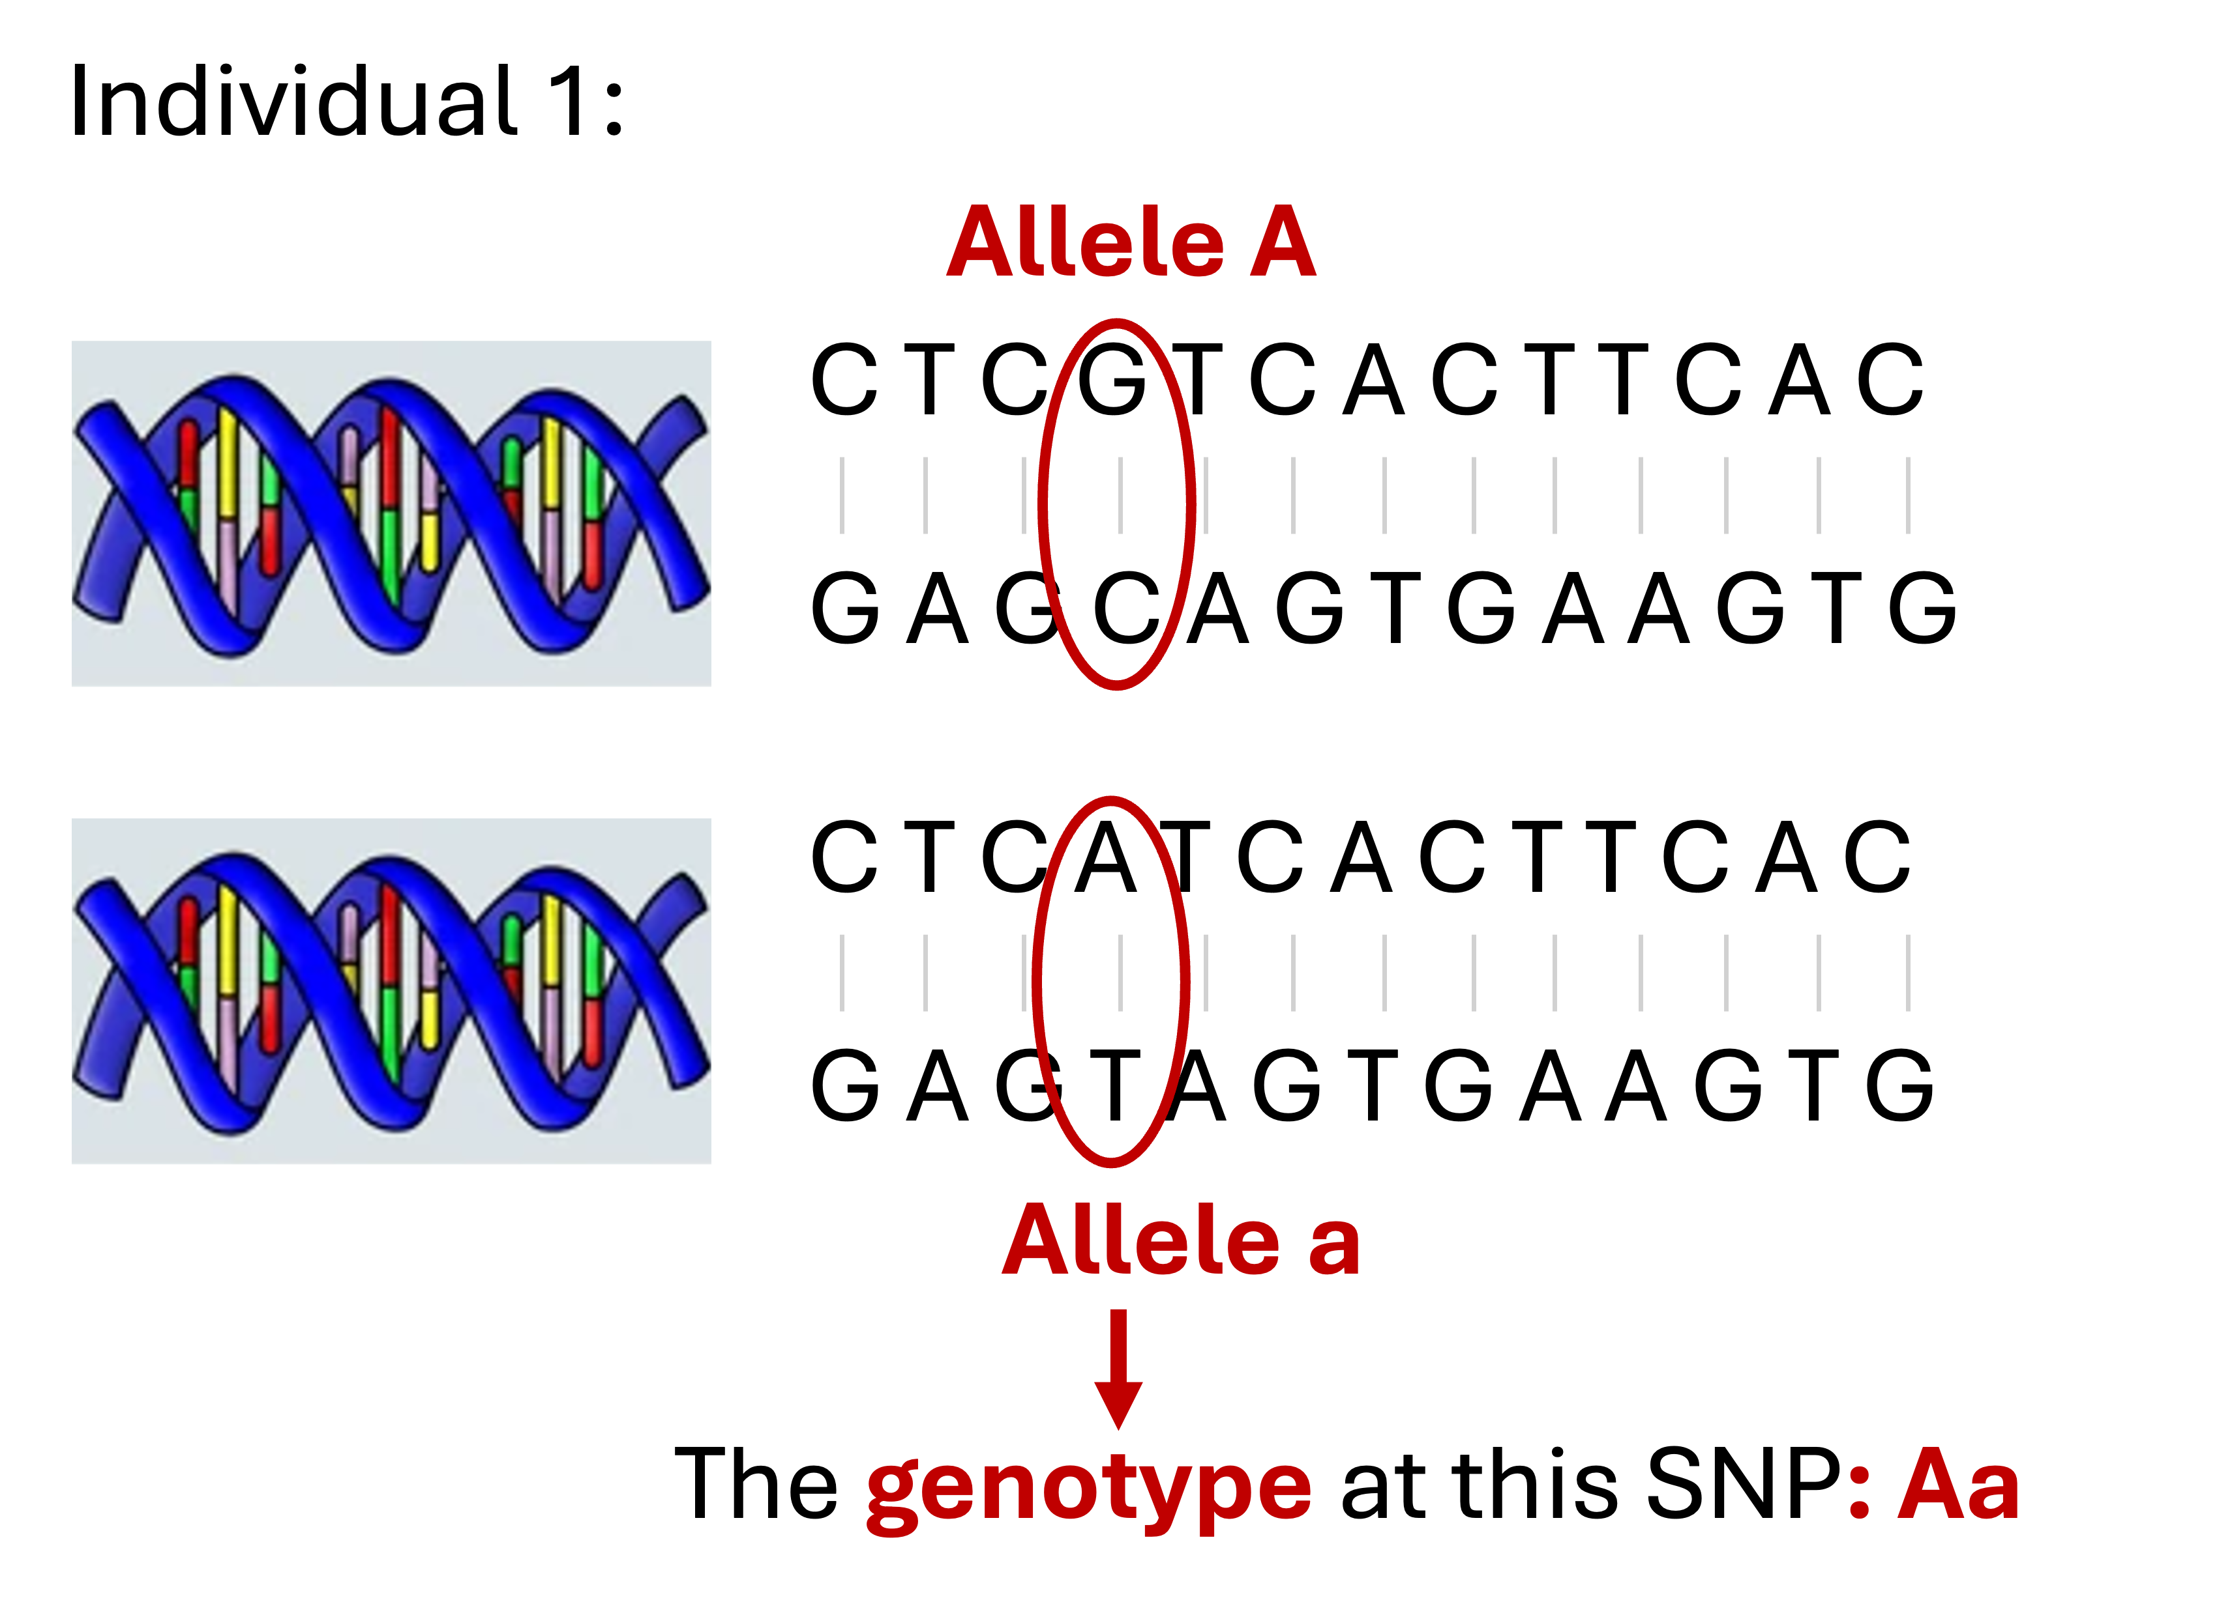


Slide 8
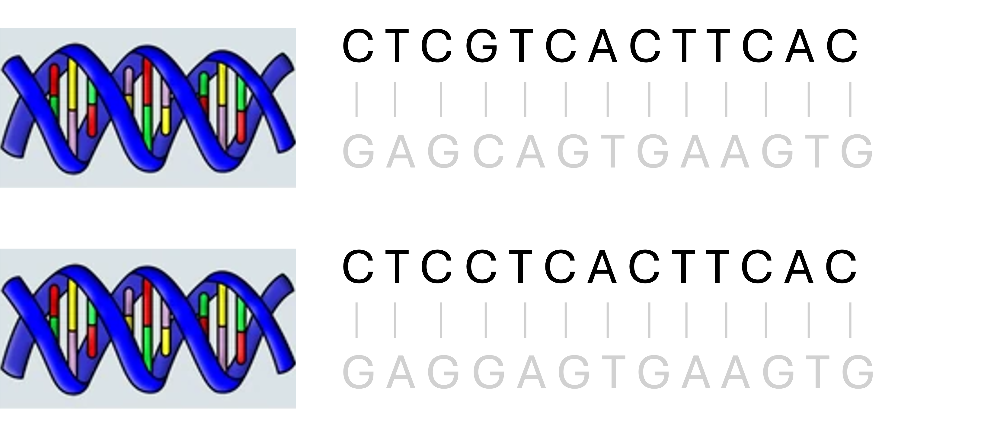
Allele A
Allele a
Genotype: Aa

Slide 9
C T C G T C A C T T C A C

Slide 11
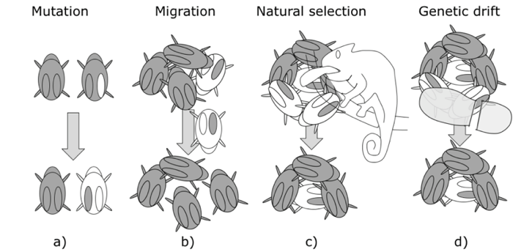
Source: Publicly available from Google Images

Slide 12
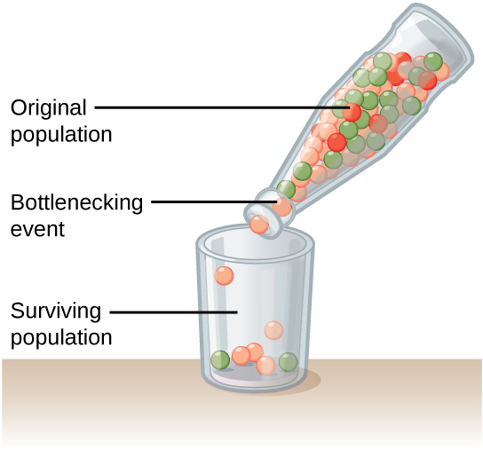
Source: Publicly available from Google Images

Slide 13
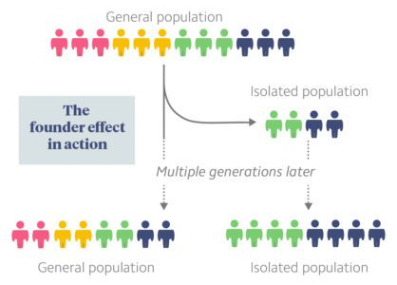
Source: Publicly available from Google Images

Slide 14
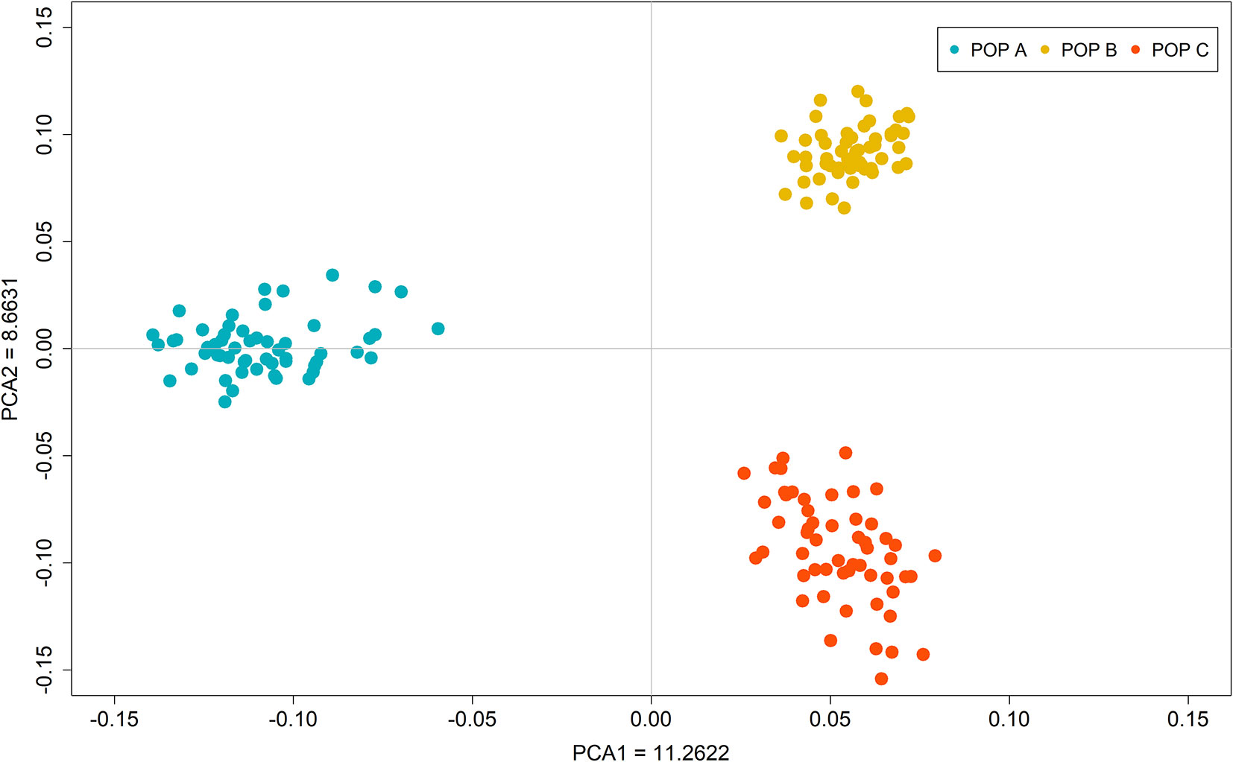
Source: Publicly available from Google Images

Slide 15
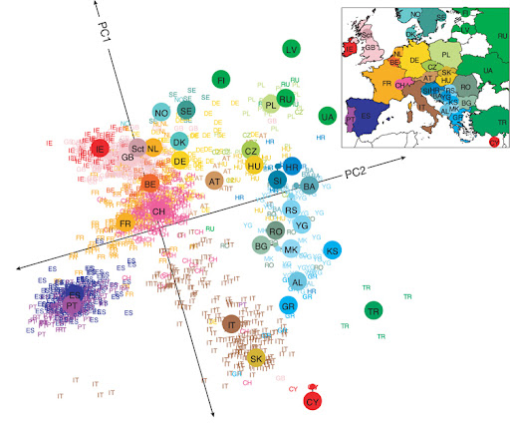
Population Structure in Europe
Source: Publicly available from Google Images

Slide 16
Recessive
X | G
1 | AA
0 | Aa or aa
Dominant
X | G
1 | AA or Aa
0 | aa
Additive
X | G
2 | AA
1 | Aa
0 | aa
Source: Created by Fan Wang

Slide 17
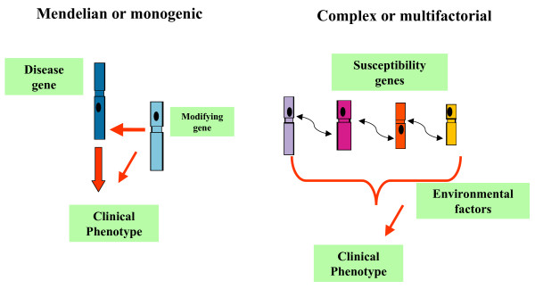
Source: Publicly available from Google Images

Slide 18
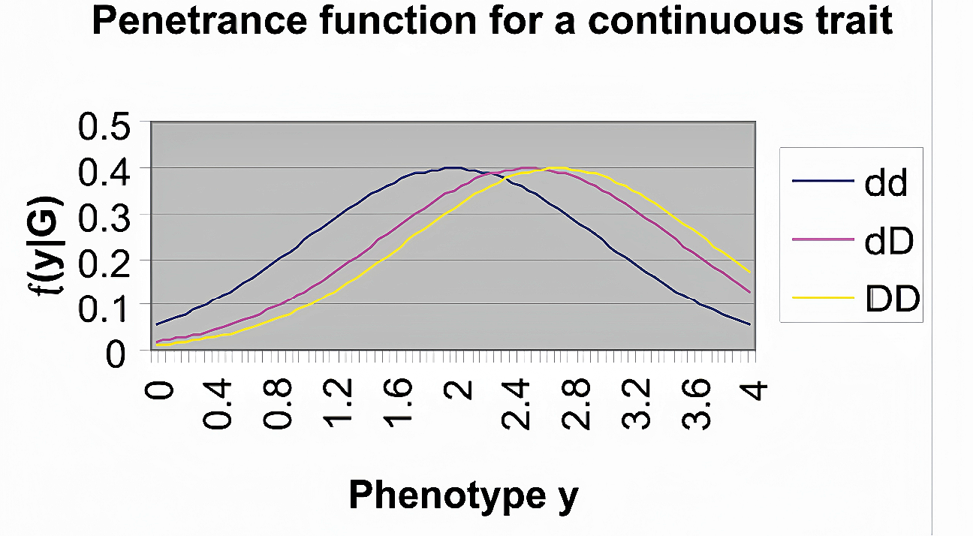
Source: Publicly available from Google Images

Slide 19
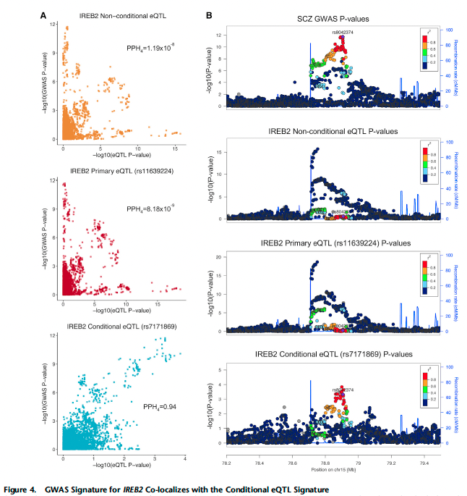
Source: Publicly available from Google Images

Slide 20
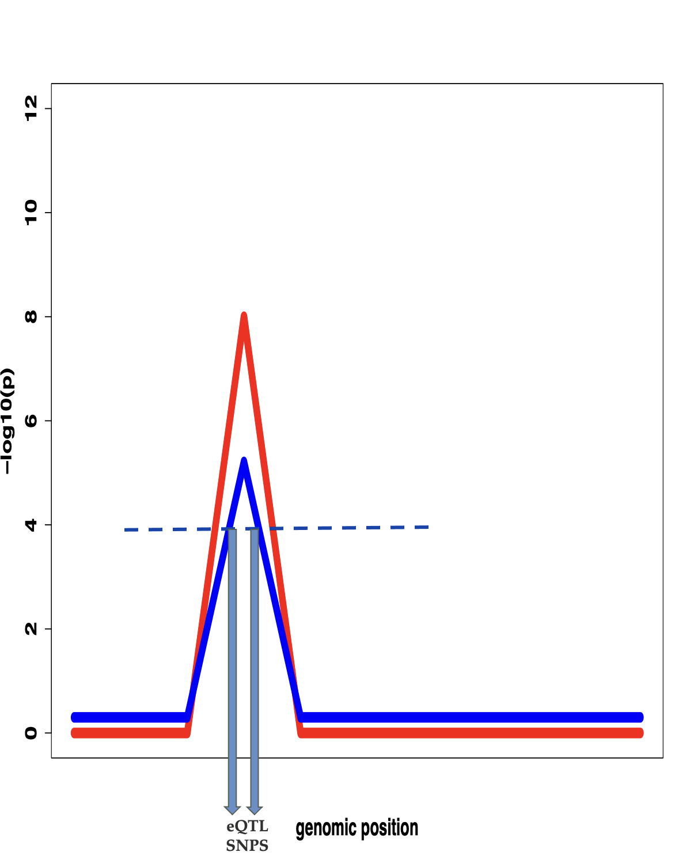
One-sided test is performed because only a significant positive value suggests colocalization of GWAS association and eQTL evidence.
Source: Image created by Fan Wang

Slide 21
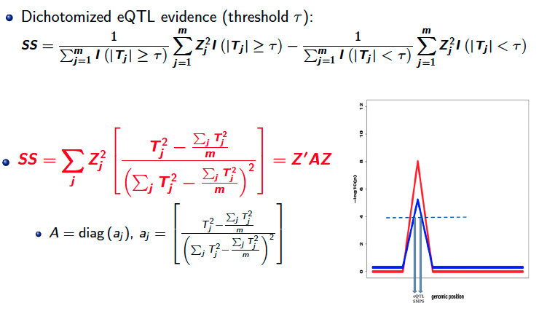

Slide 22
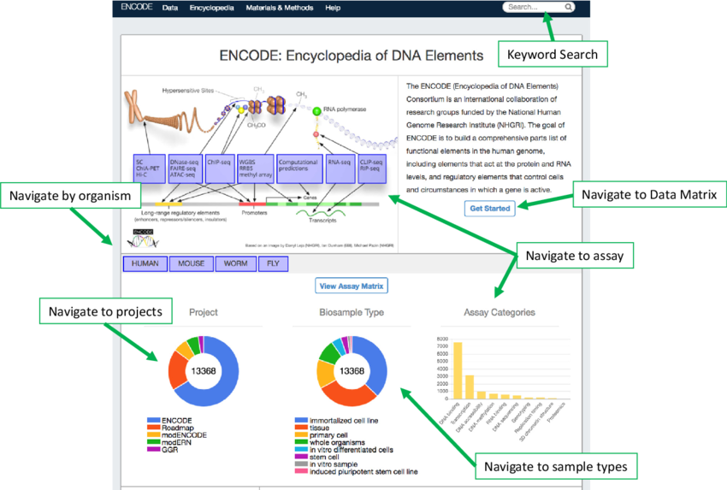
Source: Publicly available from Google Images

Slide 23
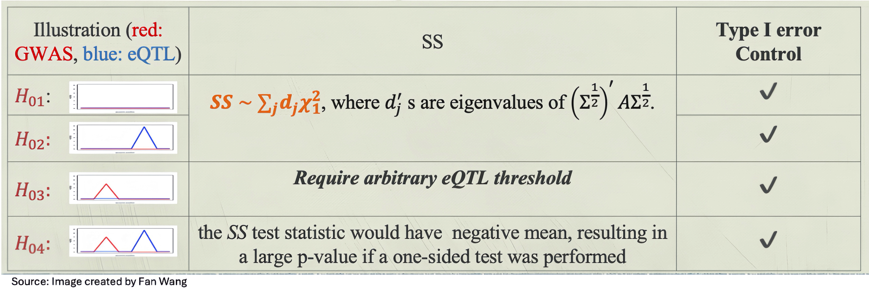

Slide 24
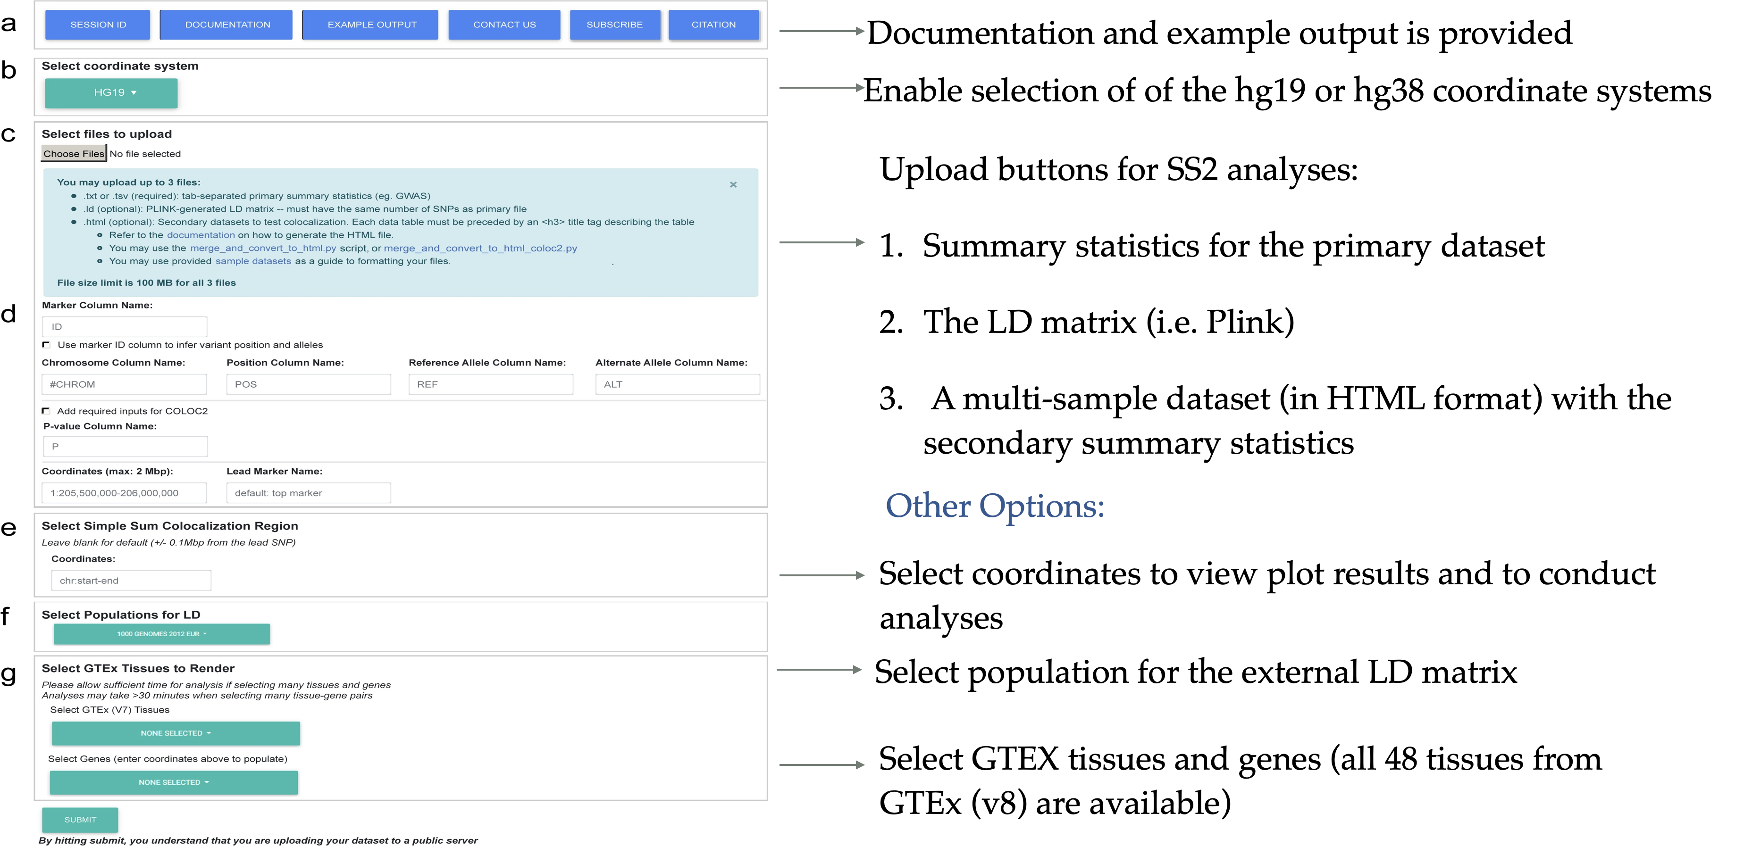
Source: Created by Fan Wang

Slide 25
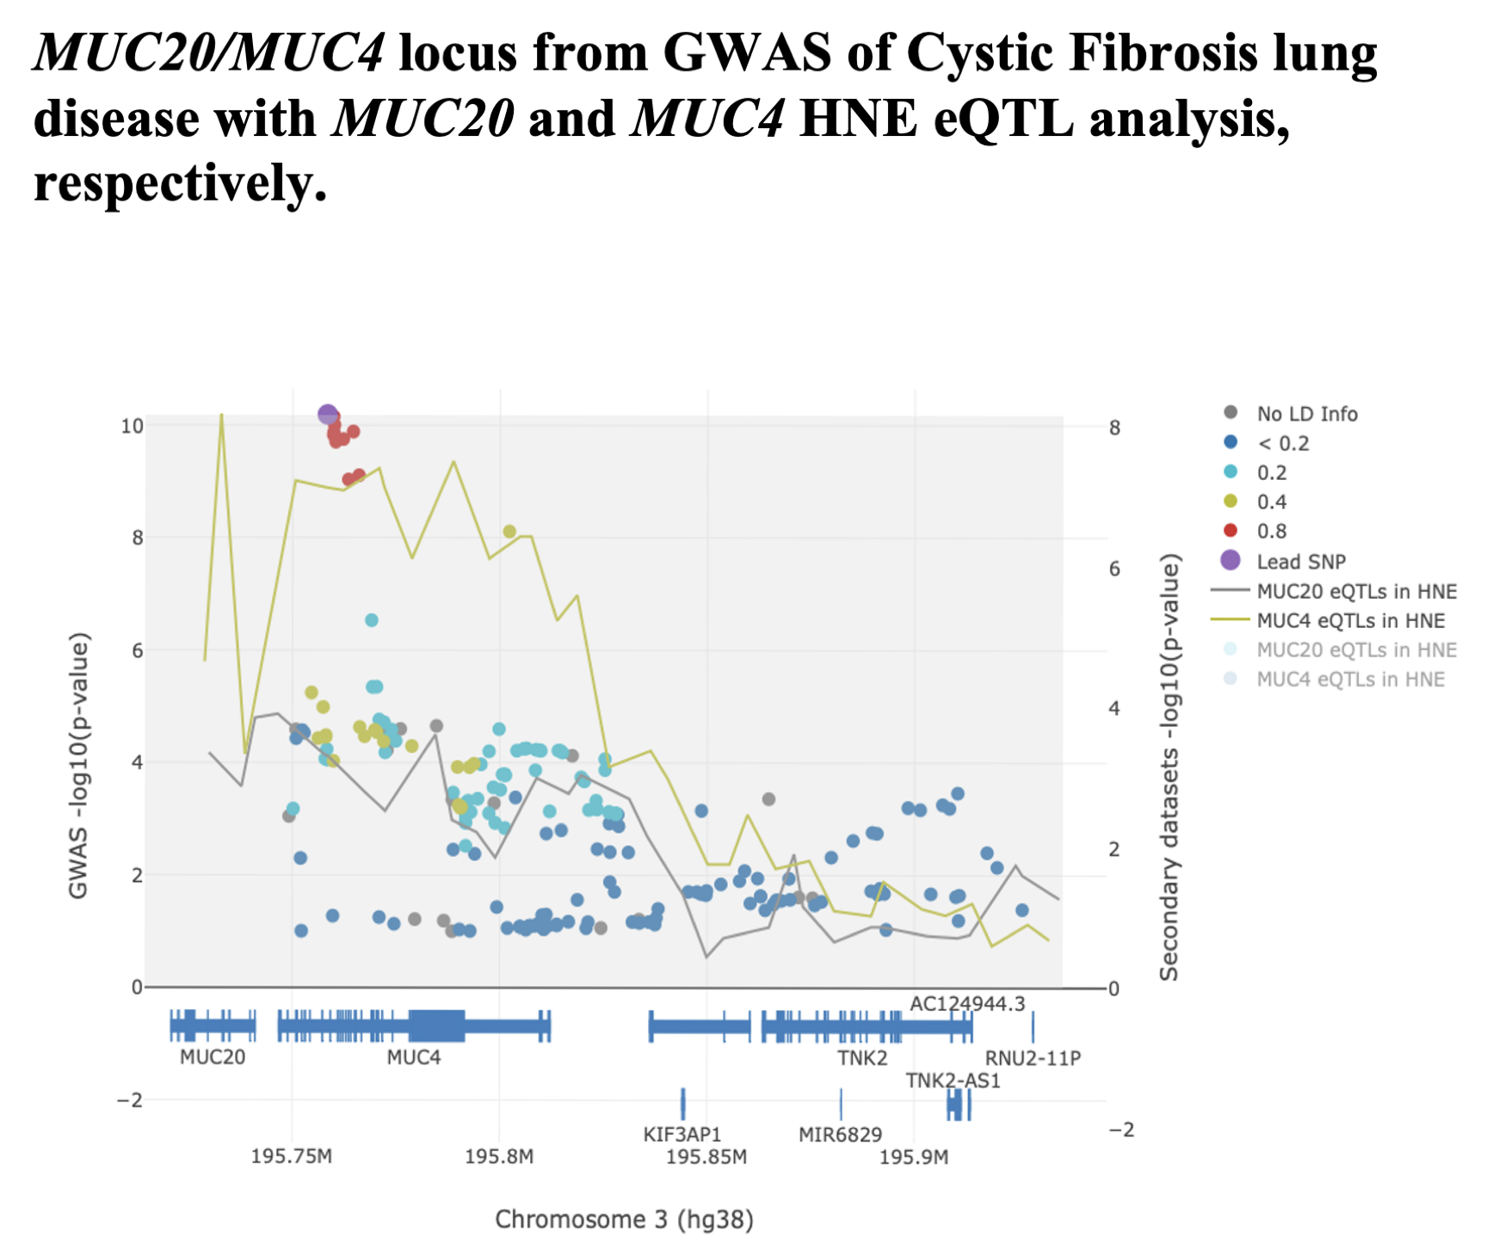
Source: Image created by Fan Wang

Slide 26
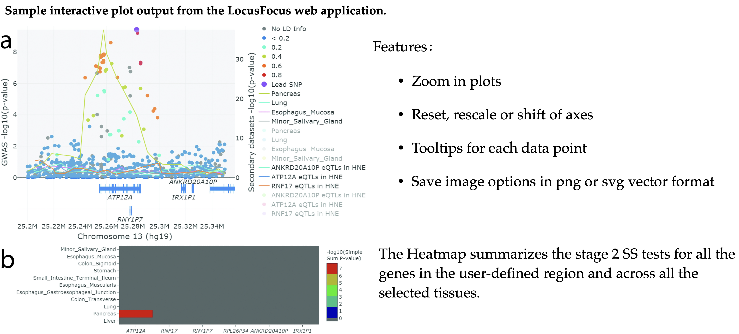
Source: Image created by Fan Wang

Slide 27
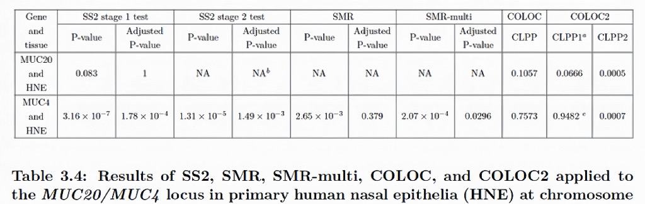
Source: Image created by Fan Wang

Slide 28
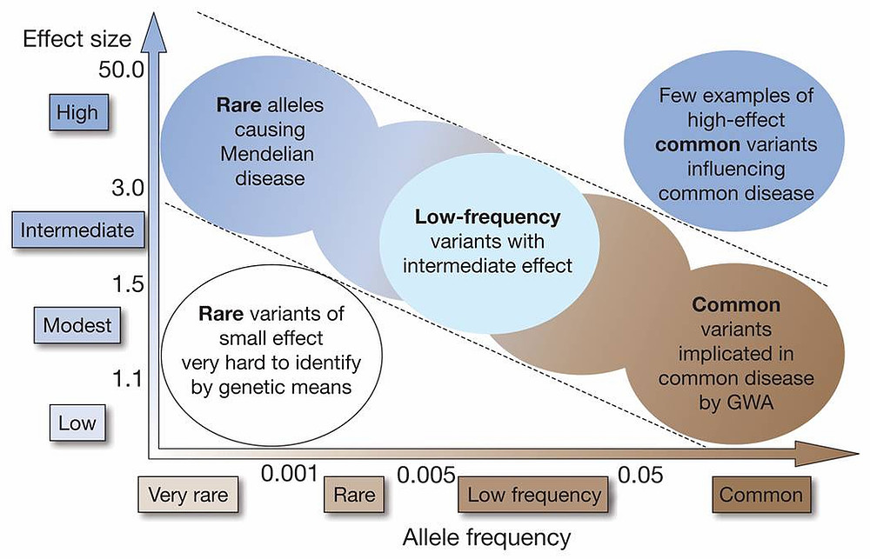
Source: Publicly available from Google Images

Slide 29
Raw short reads
Mapping and alignment
Solexa
Region 1
Region 2
SOLiD
Human reference genome
454
A single run of a sequencer generates ~50M ~75 – 400 bp short reads for analysis
The origin of each read from the human genome sequence is found
Quality calibration and annotation
Identifying genetic variation
Region 1
Region 2
Region 1
Region 2
Human reference genome
Human reference genome
SNP
The quality of each read is calibrated and additional information annotated for downstream analyses
SNPs and indels from the reference are found where the reads collectively provide evidence of a variant
Source: Publicly available from Google Images

Slide 30
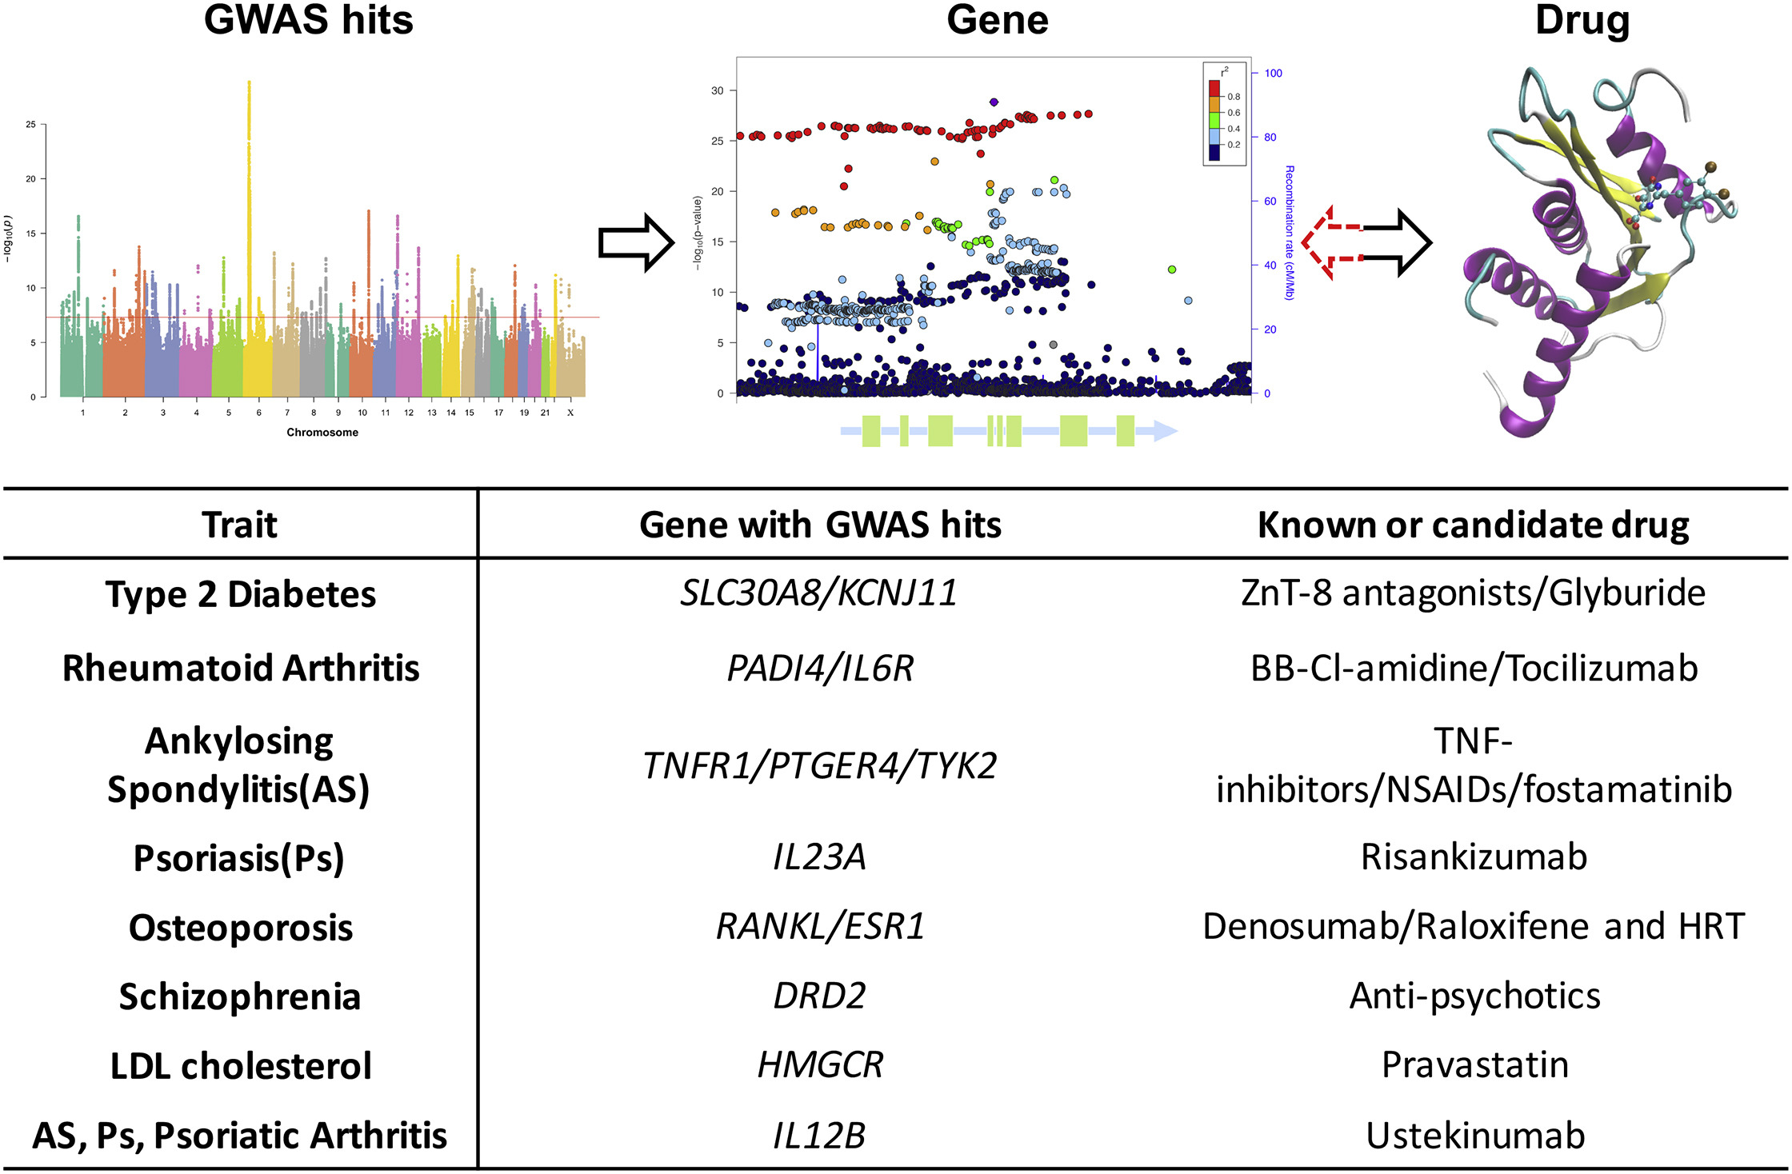
Source: Publicly available from Google Images

Slide 31
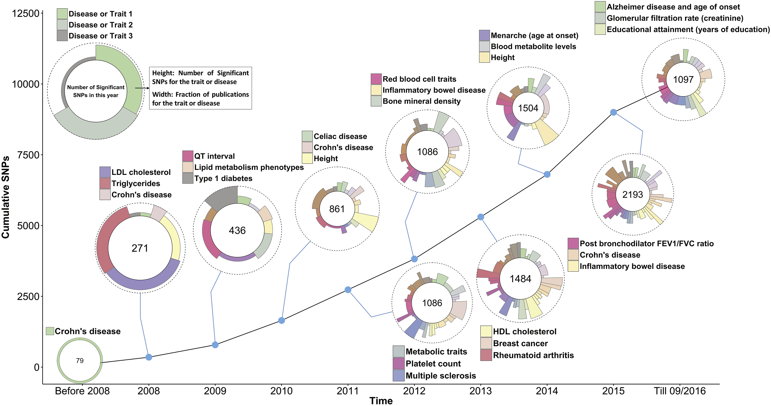
Source: Publicly available from Google Images

Slide 32
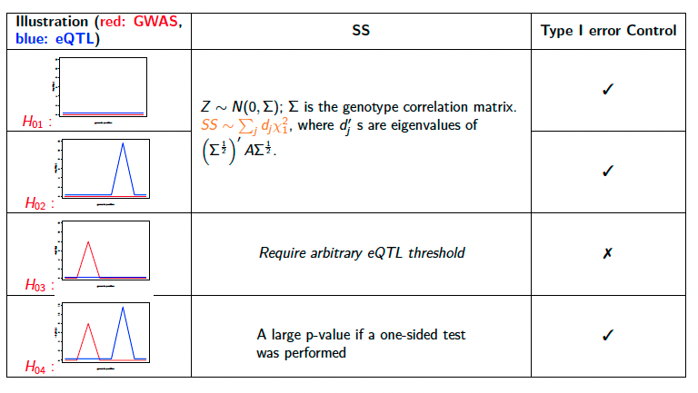

Slide 33
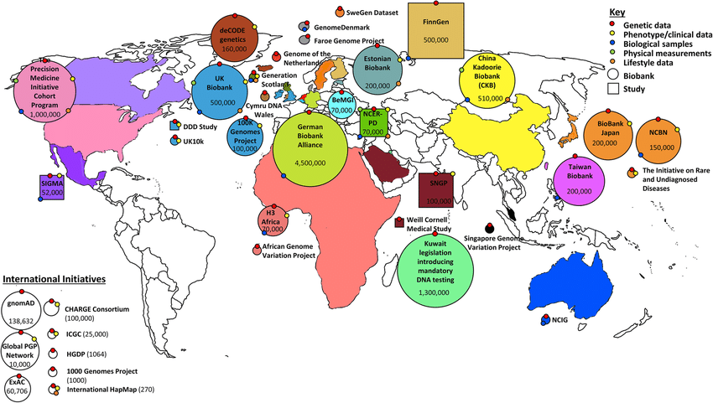
Source: Publicly available from Google Images

Slide 34
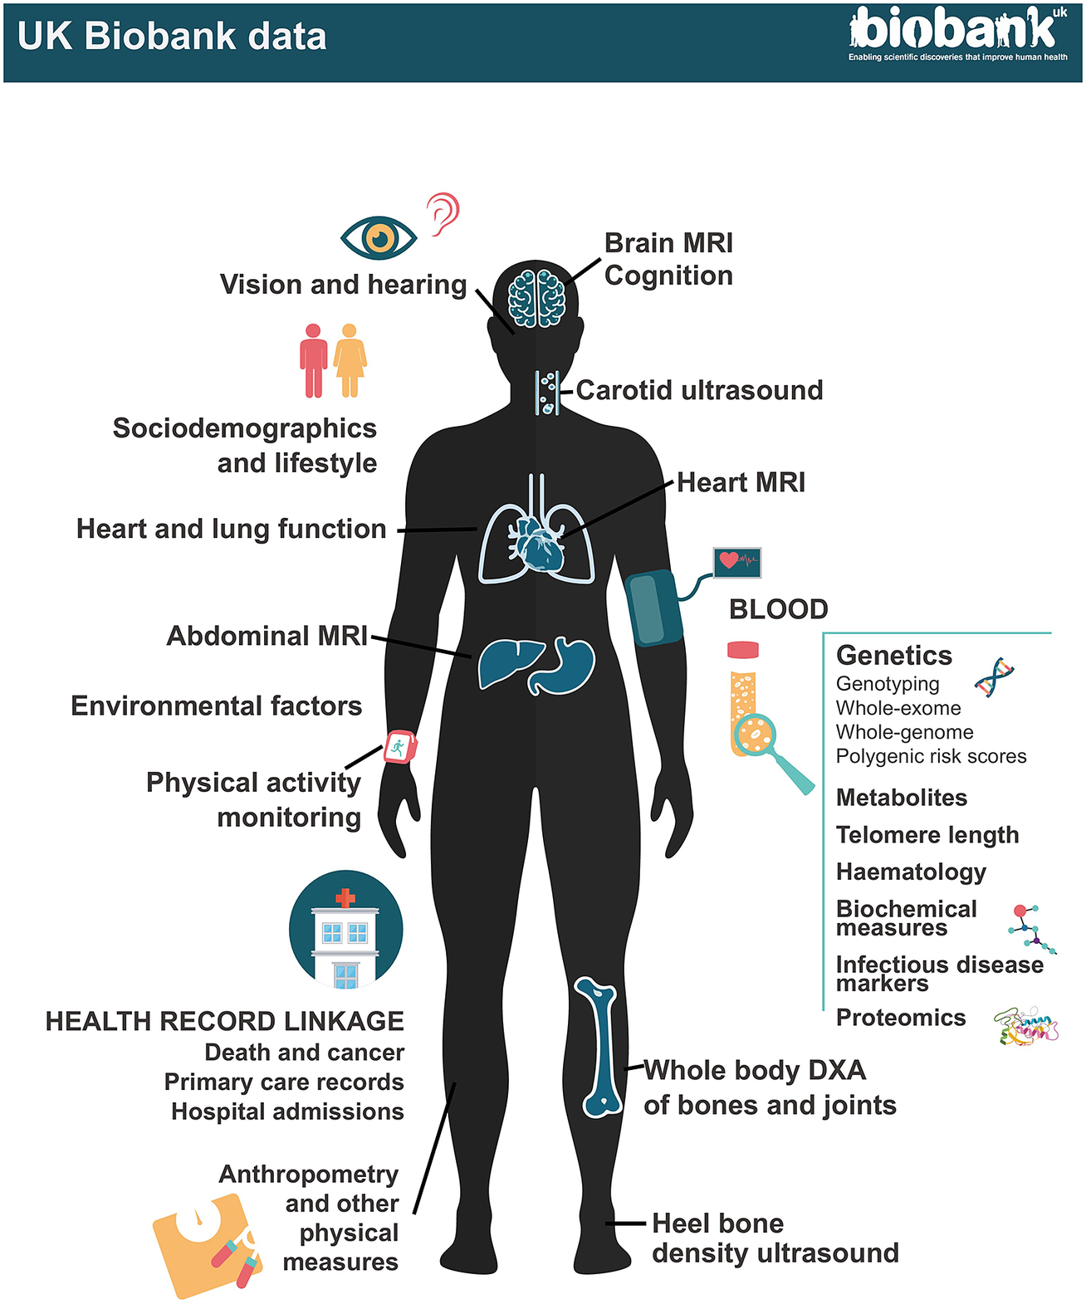
Source: Publicly available from Google Images

Slide 35
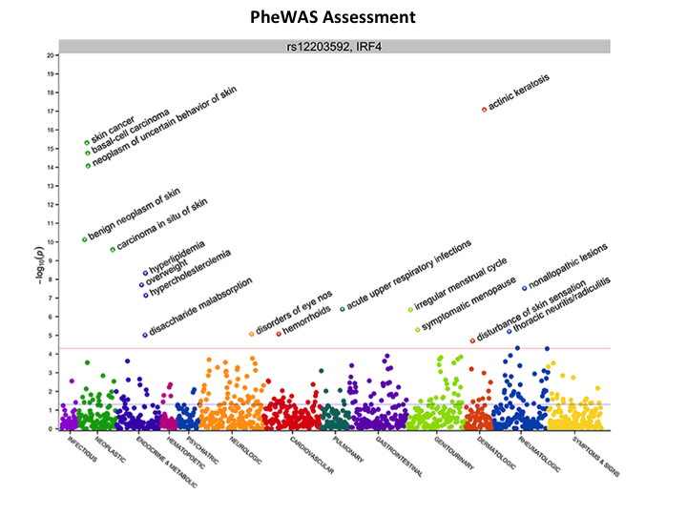
Source: Publicly available from Google Images

